Slide 1
FHWA Title VI Audit Interpretations

Slide 2
Agenda
Introduction
Internal Review
Activities to Ensure Nondiscrimination
Meet Our Team
General Guidelines
External Review

Slide 3
Introduction
The Biden administration has put renewed emphasis on certain Civil Rights programs and because of that, the administration has tasked federal agencies with improving their oversight of these programs. Title VI is one of those programs that is being looked at more closely now than before. We were provided with insight on how our KYTC Title VI implementation plan is to look and what items FHWA will be looking for when KYTC Civil Rights submits their implementation plan to Federal Highways for review.

Slide 4
Internal Review
Year One: Planning
Year Two: Environmental Analysis
Year Three: Construction and Right of Way

Slide 5
Activities to Ensure Nondiscrimination
Desk Audits
Interviews
Shadowing
Technical Assistance
Attendance at Public Outreach Events

Slide 6
Desk Audits
By requesting and reviewing the documents used by KYTC’s program areas, the Title VI staff can determine the extent to which Title VI activities are woven into the activities of those units. This review looks primarily for the presence of standard Title VI assurance language, as needed. This is also and opportunity for KYTC’s Title VI staff to identify opportunities for Title VI data gathering and/or training opportunities.

Slide 7
Interviews
KYTC’s Title VI staff relies on in-person interviews of program area staff to determine the extent of compliance with Title VI obligations. These interviews may reach both managerial and frontline staff. The interviews are used to ensure all staff understand the importance of Title VI activities and the resources available to address Title VI concerns.

Slide 8
Shadowing
This describes instances where KYTC’s Title VI staff will accompany program area staff on their business activities in order to better understand the nature of their work (and possible Title VI risk factors therein) as well as monitor staff for compliance with Title VI obligations.

Slide 9
Technical Assistance
KYTC’s Title VI staff provides technical assistance on Title VI compliance across the agency. This can include identifying language needs in impacted communities, informing reasonable accommodation interactive process, developing new methods of data collection and analysis, and providing recommendations on new Title VI related questions and issues. This technical assistance can be prompted by the direct request of program area staff with an opportunity to gauge current levels of Title VI compliance throughout the agency as well as areas for improvement.

Slide 10
Attendance at Public Outreach Events
By attending public outreach events, such as public hearings, meetings, and information sessions, KTYC’s Title VI staff can observe program area staff in their direct interactions with members of the public. This gives the Title VI staff an opportunity to identify any needs or additional training and to ascertain the effectiveness of Title VI related request processes (such as language services and reasonable accommodations). Attending these sessions also provides an opportunity to learn of project-level community concerns that may be Title VI related.

Slide 11
General Guidelines
The cornerstone of Title VI compliance in all KYTC is outreach and public involvement. KYTC strives to provide early, continuous, and extensive outreach to all communities, but particularly to ensure that project selection does not subject populations to disparate, adverse effects based on race, color, or national origin.

Slide 12
Process
Collecting and analyzing data on minority and low-income populations to determine the potential impact of proposed plans, programs, and projects.
Sampling of contracts to ensure inclusion of required nondiscrimination provisions as well as nondiscrimination in the selection of consulting firms.
Ensuring that all people are treated equitably regardless of race, color, or national origin.
Developing and updating internal policies and procedures to ensure Title VI compliance during all phases of projects and activities.

Slide 13
Process
Sampling of public involvement materials including meeting notices, project flyers and other similar documents to ensure appropriate nondiscrimination language and to ensure that such outreach is conducted in other languages as appropriate.
Interviewing district staff to identify emerging issues and needs.
Sampling environmental documents to ensure Community Impact Assessments appropriately identify underserved communities and discuss avoidance, minimization, and mitigation or potentially disproportionate, adverse impacts.
Choosing media outlets and other disbursement networks to ensure access to traditionally underserved and LEP customers.

Slide 14
Process
Ensuring that meetings, hearings, and other public involvement events are held in accessible locations and at times to garner the best representation of the impacted community: and/or
Collecting questions, concerns, comments, or complaints from the public, ensuring they are appropriately addressed and forwarding potential discrimination concerns to the appropriate officials.

Slide 15


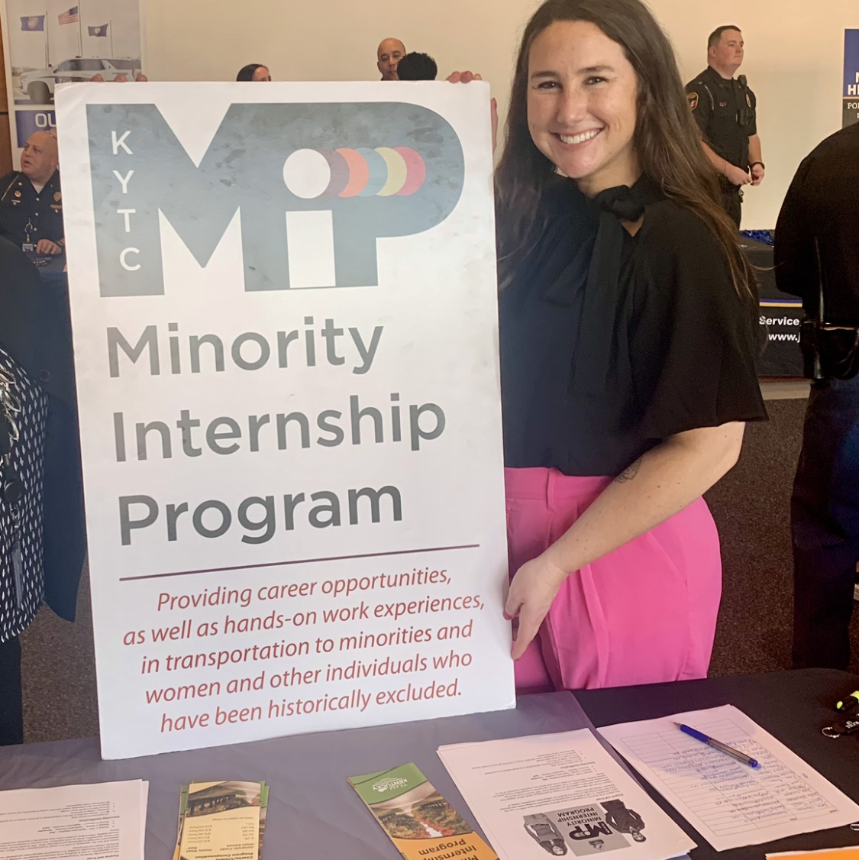
Meet our team
Tiffany Squire
Caleb Houchens
Administrative Branch Manager
Program Investigator II
Catessa Barnes
Program Investigator II

Slide 16
External Review
Title VI Implementation Plans
Submission for review and approval annually
On-site Reviews
Questionnaire
Federal labor laws and Title VI Notice to the Public properly posted

Slide 17
Title VI Plan Updates
Protected classes
Race, color, and national origin only
Policy statement, notice to the public, complaint form
Standard Assurances
Must keep identical to original USDOT contract
Only change organization specific language

Slide 18
Title VI Plan Updates
Complaint Procedures
ALL Title VI complaints routed to FHWA Headquarters - Office of Civil Rights
FHWA determines if complaint is accepted or dismissed
If accepted, FHWA will conduct the investigation
FHWA issues Letter of Finding at conclusion of investigation
Notes:
Title VI is a federal law, thus FHWA has the federal regulatory authority on Title VI issues stemming from entities receiving funds from them.
No agency will have responsibility for investigating a complaint filed against themselves to avoid that conflict of interest.
FHWA has the final decision on actions taken as the result of any investigation, even one they delegated. A letter of finding issued by FHWA is administratively final, so no appeals process is available.

Slide 19
Sub-Recipient On-Site Review
Questionnaire
Used to identify any shortfalls or areas needing improvement in the implementation of your Title VI Program.
Federal labor laws poster
Posted in an employee common area.
Title VI Notice to the Public
Posted in the lobby or other area accessible by the public.

